Slide 1
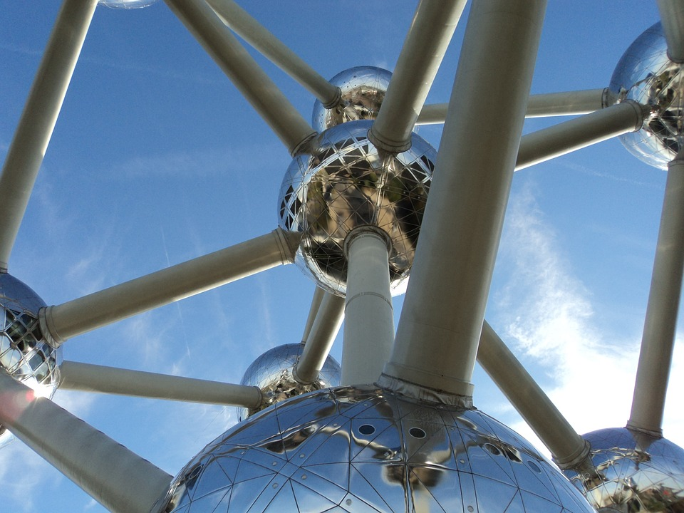

Week 2
Atomic Design

Slide 2
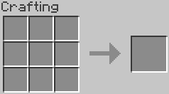
What is atomic design?
Atomic design is an approach to building scalable, maintainable systems.
It work’s kind of like crafting in Minecraft.
It can be applied to any project, not just HTML.
“We’re not designing pages, we’re designing a system of components.” ~ Stephen Hay
http://bradfrost.com/blog/post/atomic-web-design/

Slide 3
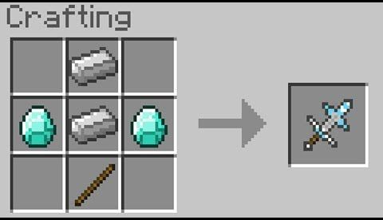
What is atomic design?
Atomic design has 5 ‘levels’:
Atoms: our raw ingredients
Molecules: a unique combination of atoms.
Organisms: a unique combination of molecules.
Templates: a unique combination of organisms.
Pages: a unique instance of a template.
http://bradfrost.com/blog/post/atomic-web-design/

Slide 4
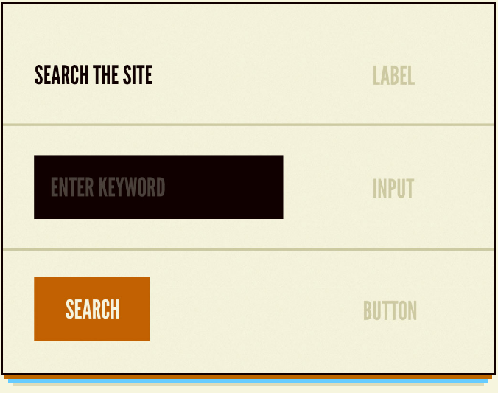
What is atomic design?
Atoms
At the lowest level, we have atoms.
These are our raw materials.
In the case of a web project, that would be our raw HTML tags.
http://bradfrost.com/blog/post/atomic-web-design/

Slide 5
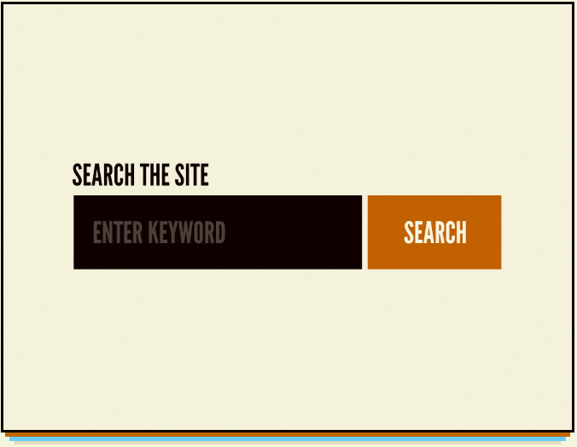
What is atomic design?
Molecules
We combine atoms to create molecules, which are discrete ‘blocks’ of functionality.
By combining our atoms from the previous slide, we can create a search form molecule.
This molecule can be reused throughout the site, without any code changes, and will always look and behave exactly the same way.
http://bradfrost.com/blog/post/atomic-web-design/

Slide 6
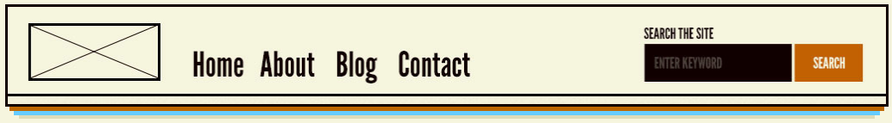
What is atomic design?
Organisms
We can then combine molecules together to create organisms.
These are self-contained, complete ‘sections’ of a webpage.
For example, we may combine our search-form molecule with our nav-bar molecule to create our site header organism.
http://bradfrost.com/blog/post/atomic-web-design/

Slide 7
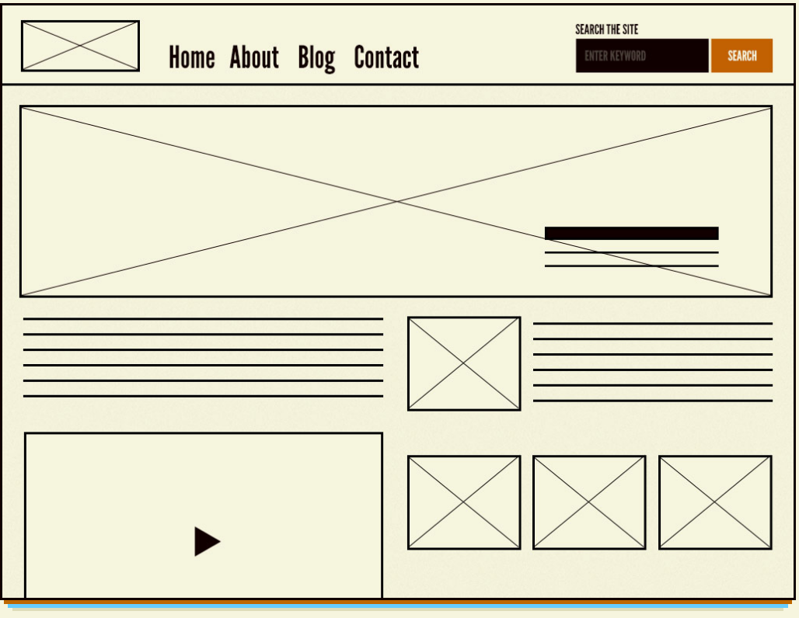
What is atomic design?
Templates
We can then combine organisms to form our templates.
The example on the right might be a ‘blog-post.html’ template.
Note that the template does not contain any content, it only specifies where and how the content is presented.
http://bradfrost.com/blog/post/atomic-web-design/

Slide 8

What is atomic design?
Pages
Finally, we create instances of our templates by dropping content into them to create unique pages.
We could have 50 unique blog posts, all using the same template.
http://bradfrost.com/blog/post/atomic-web-design/

Slide 9
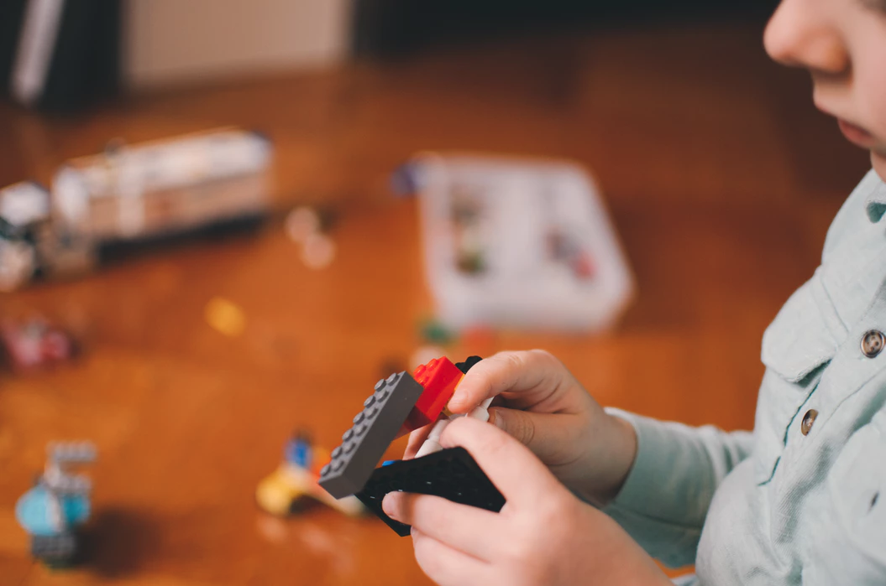
Why is atomic design useful?
Systems are living, breathing things. In time they will grow, evolve, and change.
Atomic design helps us organise our systems into discrete, logical pieces, that can be combined, reused, or changed with minimal fuss.

Slide 10
Why is atomic design useful?
It also helps to keeps our output consistent.
There is nothing worse than a website that looks inconsistent from one page to the next. It’s a usability nightmare, and it looks amateurish.
Atomic design avoids that by keeping most of the behaviour at the low level, we usually only need to make subtle adjustments as we combine elements.

Slide 11
Why is atomic design useful?
Finally, it helps us stick to the two golden rules of programming:
DRY (don’t repeat yourself)
KISS (keep it simple, stupid)

Slide 12
HTML
<label>I am an Atom.</label>
<input type=”textbox” value=”I am an atom too.” />
<button type=”submit”>I am also an atom.</submit>
CSS
label {
font-weight: bold;
}
input {
background: #f0f0f0;
border: 1px solid #333;
border-radius: 4px;
padding: 8px 1em;
}
button {
background: white;
color: black;
border: 1px solid black;
padding: 8px 1em;
border-radius: 4px;
transition: all 0.4s ease-in-out;
}
button:hover{
background: black;
color: white;
}
How do we implement atomic design?
Atoms
Remember, in a web project, raw HTML tags are our atoms, so work with them first.
In the example on the right, we are applying default styles to some commonly used elements;
Labels
Inputs
Buttons

Slide 13
HTML
<h2>This is a search-form molecule.</h2>
<div class=”search-form”>
<label>Enter a search term</label>
<input type=”textbox” name=”searchTerm” />
<button type=”submit”>Search</submit>
</div>
CSS
.search-form{
background: grey;
clear: both;
overflow: hidden;
max-width: 400px;
}
.search-form input {
float: left;
width: 200px;
}
.search-form button {
float: left;
}
How do we implement atomic design?
Molecules
We’ll now combine a few HTML tags (atoms) to create something meaningful - a search form (molecule).
Since we have already given our atoms their basic styling, all our search-form CSS is super simple.
Infact, all we’re doing in this example is changing the background colour of the form and making the search box + button inline.

Slide 14
HTML
<h2>This is a header organism.</h2>
<header>
<img src=”assets/img/logo.png” />
<nav>{...}</nav>
<div class=”search-form”>{...}</div>
</header>
CSS
header img {
float: left;
max-width: 200px;
margin-right: 1em; // 16px;
}
header nav {
float: left;
}
header .search-form{
float: right;
background: #C0C0C0;
}
How do we implement atomic design?
Organisms
We’ll now define our first fully-fledged page section (organism) - the header.
In the example on the right, the nav and search form have been abbreviated, but these will have been built and styled as individual molecules.
Again, our HTML and CSS is super simple - just positioning and subtle adjustments.

Slide 15
HTML
<html>
<head>{...}</head>
<body class=”blog-post”>
<header>{...}</header>
<main>
<article>{...}</article>
<aside class=”sidebar”>{...}</aside}
</main>
<footer>{...}</footer>
</body>
</html>
CSS
article {
float: left;
width: 70%;
padding-right: 2em;
box-sizing: border-box;
}
aside {
float: left;
width: 30%;
}
How do we implement atomic design?
Templates
Now we’ll combine several organisms to create our first template - the blog-post.html.
This template has a proper anatomy, with a html, head, and body tag.
Everything between the body tag is the unique recipe for this template.
Again, HTML and CSS is super simple! This will give us a main content area and a sidebar.

Slide 16

How do we implement atomic design?
Pages
We won't be demonstrating pages in this week's session. But these are usually populated using a Content Management System (CMS).
WordPress and Umbraco are two popular CMS’, but there are literally hundreds!
In the future we will implement our templates in the Umbraco CMS, and use it to create some pages.

Slide 17
Any questions?

Slide 18

This weeks exercise:
This weeks exercise you have been given a design to implement and a partially finished solution.
You must complete the solution according to the design using only HTML and CSS.

Slide 19
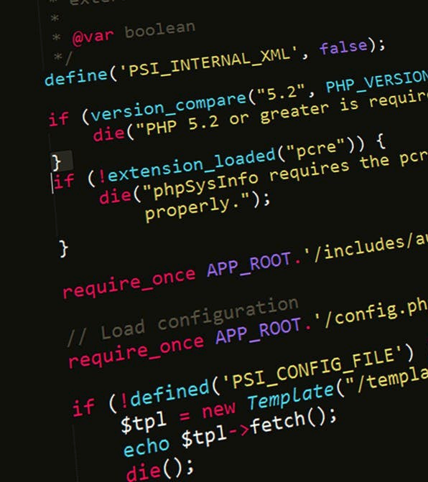
One more thing...
Please make sure you complete the weekly exercises.
I can’t help you if you don’t share you git repo.
These exercises will make your project much easier!

Slide 20
